Slide 1

Bressenhem (Line and Circle)
Fera Putri Ayu Lestari, S.Kom., M.T.
Grafika Komputer – Informatika – UMM

Slide 2
overview
Review DDA
Bressenhem line
Exercise
Bressenhem circle
Exercise

Slide 3
review
Digital Differential Analyzer (DDA) is
a line formation algorithm based on the calculation of ∆x and ∆y, using the formula
∆y = m ∆x
The line is created by specifying two endpoints, namely starting point and end point

Slide 4
DDA Implementation
Step 1-2
To describe the DDA algorithm in the formation of a line connect the dots A(10, 10) and B(17, 16).
Where A as starting point and B as end point.
Step 3 (determine dx and dy)
∆x = x1 – x0 = 17 – 10 = 7 → |∆x| = 7
∆y = y1 – y0 = 16 – 10 = 6 → |∆y| = 6
Step 4 (look for steps )
Because |∆x| > |∆y| is fulfilled, then “step” is |∆x| = 7
Step 5 (get x_increment and y_increment)
x_increment = 7/7 = 1
y_increment = 6/7 = 0,86

Slide 5
Next DDA implementation [A(10, 10) and B(17, 16)]
Step 6-7
x + x_increment → 10 + 1 = 11
y + y_increment → 10 + 0,86 = 10,86 = 11
Step 8 (repeat from step 6-7)
x + x_increment → 11 + 1 = 12
y + y_increment → 10,86 + 0,86 = 11,72 = 12
until x = x1(17) and y = y1(16)
k | x | y | Round(x), Round(y)
 |  |  | (10,10)
0 | 11 | 10.86 | (11,11)
1 | 12 | 11.72 | (12,12)
2 | 13 | 12.58 | (13,13)
3 | 14 | 13.44 | (14,13)
4 | 15 | 14.3 | (15,14)
5 | 16 | 15.16 | (16,15)
6 | 17 | 16.02 | (17,16)
As the result :

Slide 6
Bressenhem
Line

Slide 7
Introduction
Procedure for redrawing the line by rounding the x or y value integer takes loss time, and the variables x, y and gradient m are numbers real because slope is a fractional value.
Bressenham develops classic algorithm that is more interesting, because it only uses calculations math with integer numbers. Thus there is no need to round up the value position of each pixel every time.

Slide 8
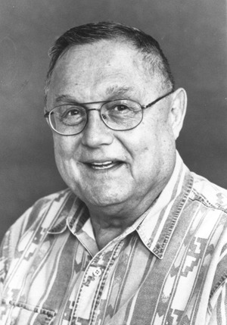
Dr. Jack Elton Bresenham
Bresenham's Line Algorithm is used for scan converting a line.
It was developed by Dr. Jack Elton Bresenham.
It is an efficient method because it involves only integer addition, subtractions, and multiplication operations.
These operations can be performed very rapidly so lines can be generated quickly.
Dr. Jack Elton Bresenham

Slide 9
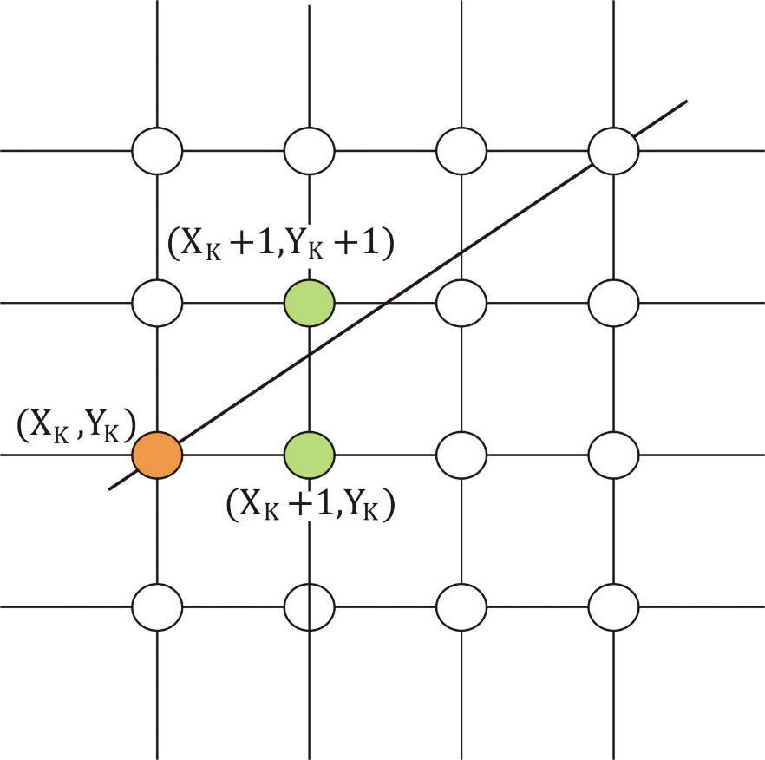
In this method, next pixel selected is that one who has the least distance from true line.
We always increase x by 1, and we choose about next y, whether we need to go to y+1 or remain on y.
In other words, from any position (X_{k}, Y_{k}) we need to choose between (X_{k} + 1, Y_{k}) or (X_{k} + 1, Y_{k} + 1)
y = mx + c

Slide 10
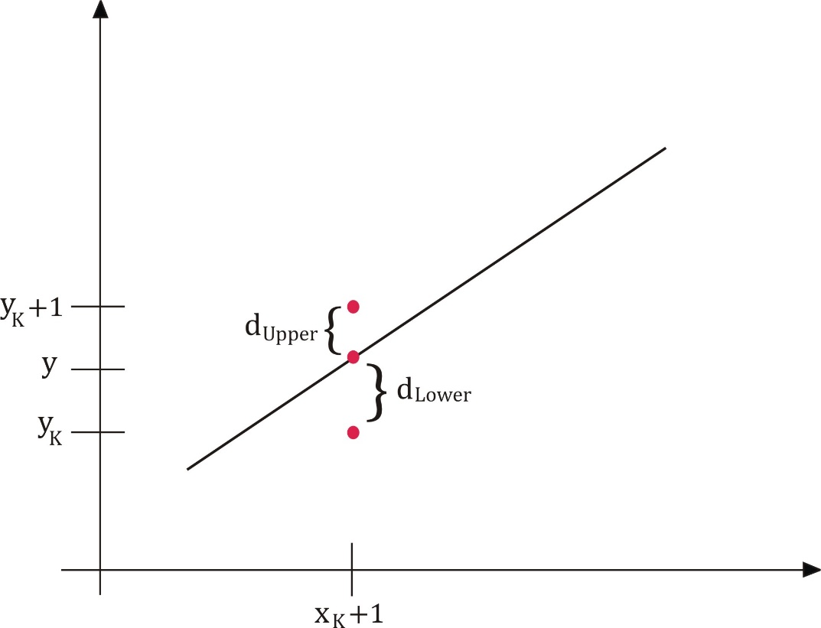
The next selected pixel is
Either the one to its right (lower-bound for the line), d_{lower}
OR
One top its left and up (upper-bound for the line), d_{upper}
Bresenham's algorithm selects the nearest point from the actual path

Slide 11
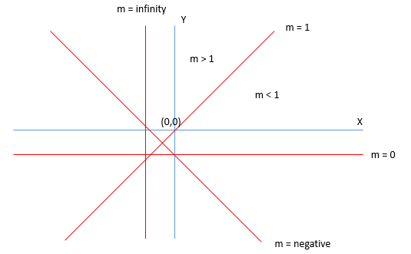
Gradient Angle

Slide 12
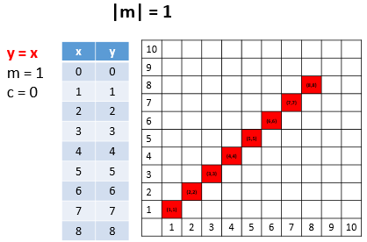
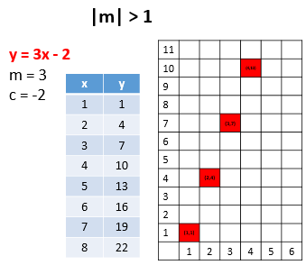
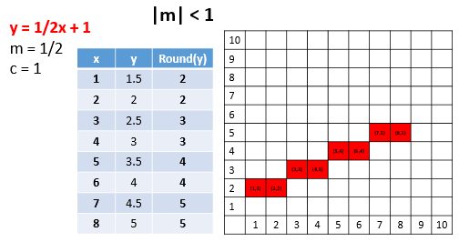
y = mx + c for various m

Slide 13
How to
The steps to form a line according to the Bressenhem algorithm are:
Determine the two points will be connected.
Specify one point on the left as the starting point (x0, y0) while the other point is end point (x1, y1).
specify the value of m.
Calculate parameters p0,
if m < 1, p0 = 2∆y - ∆x or
if m > 1, p0 = 2∆x - ∆y
For m < 1, it starts with k = 0
If pk < 0 then the next point is (xk + 1, yk) and pk+1 = pk + 2∆y
If not then the next point is (xk + 1, yk + 1) and pk+1 = pk + 2∆y - 2∆x
For m > 1, it starts with k = 0
If pk < 0 then the next point is (xk, yk + 1) and pk+1 = pk + 2∆x
If not then the next point is (xk + 1, yk + 1) and pk+1 = pk + 2∆x - 2∆y
Repeat step number 5 to determine the next pixel position, until x = x1 and y = y1.

Slide 14

Slope Line (m)
y - b = m (x - a)
$m=\frac{y−b}{x−a} or m=\frac{y_{2}−y_{1}}{x_{2}−x_{1}}$ $or m=\frac{dy}{dx}$
Parameter | m < 1 | m > 1
p_{k} | 2∆y - ∆x | 2∆x - ∆y
If pk < 0 | then (xk + 1, yk) and pk+1 = pk + 2∆y | then (xk, yk + 1) and pk+1 = pk + 2∆x
If pk ≥ 0 | then (xk + 1, yk + 1) and pk+1 = pk + 2∆y - 2∆x | then (xk + 1, yk + 1) and pk+1 = pk + 2∆x - 2∆y

Slide 15
Bressenham implementation
Step 1-2
Step 3-4
To illustrate the Bressenham algorithm in the formation of a line connecting points (10,10) and (17,16), it is first determined that the point (10,10) on the left is the starting point, while (17,16) is the end point.
∆x = x1 – x0 = 17 – 10 = 7 → |∆x| = 7
∆y = y1 – y0 = 16 – 10 = 6 → |∆y| = 6
m = ∆y/∆x = 6/7
Parameters p0 = 2∆y - ∆x → p0 = 5
= 2*6 – 7
= 12 – 7

Slide 16
Step 5 – 6 (repeated)
k = 0 ; p0 = 5
k = 1 ; p1 = 3
k = 2 ; p2 = 1
Because p0 > 0, then
pk+1 = pk + 2∆y - 2∆x
p1 = 5 + 2*6 – 2*7
p1 = 3
Next point : (xk + 1, yk + 1) → (10 + 1, 10 + 1) → (11, 11)
Because p1 > 0, then
pk+1 = pk + 2∆y - 2∆x
p2 = 3 + 2*6 – 2*7
p2 = 1
Next point : (xk + 1, yk + 1) → (11 + 1, 11 + 1) → (12, 12)
Because p1 > 0, then
pk+1 = pk + 2∆y - 2∆x
p3 = 1 + 2*6 – 2*7
p3 = -1
Next point : (xk + 1, yk + 1) → (12 + 1, 12 + 1) → (13, 13)

Slide 17
Step 5 – 6 (repeated)
k = 3 ; p3 = -1
k = 4 ; p4 = 11
18
17
16
15
14
13
12
11
10
 | 10 | 11 | 12 | 13 | 14 | 15 | 16 | 17 | 18
Because p3 < 0, then
pk+1 = pk + 2∆y
p4 = -1 + 2.6
p4 = 11
Next point : (xk + 1, yk) → (13 + 1, 13) → (14, 13)
and so on. . .
k | pk | (xk+1,yk+1)
 |  | (10,10)
0 | 5 | (11,11)
1 | 3 | (12,12)
2 | 1 | (13,13)
3 | -1 | (14,13)
4 | 11 | (15,14)
5 | 9 | (16,15)
6 | 7 | (17,16)

Slide 18
Bressenham Advantages
It involves only integer arithmetic, so it is simple.
It avoids the generation of duplicate points.
It is faster as compared to DDA (Digital Differential Analyzer) because it does not involve floating point calculations like DDA Algorithm.

Slide 19
EXERCISE
Create a line that connects from point (3, 2) to point (4, 7) using the Bressenham algorithm.

Slide 20
Slope Line (m)
y - b = m (x - a)
$m=\frac{y−b}{x−a} or m=\frac{y_{2}−y_{1}}{x_{2}−x_{1}}$ $or m=\frac{dy}{dx}$
Parameter | m < 1 | m > 1
p_{k} | 2∆y - ∆x | 2∆x - ∆y
If pk < 0 | then (xk + 1, yk) and pk+1 = pk + 2∆y | then (xk, yk + 1) and pk+1 = pk + 2∆x
If pk ≥ 0 | then (xk + 1, yk + 1) and pk+1 = pk + 2∆y - 2∆x | then (xk + 1, yk + 1) and pk+1 = pk + 2∆x - 2∆y

Slide 21
answer
Step 1-2
Step 3-4
To illustrate the Bressenham algorithm in the formation of a line connecting points (3,2) and (4,7), it is first determined that the point (3,2) on the left is the starting point, while (4,7) is the end point.
∆x = x1 – x0 = 4 – 3 = 1 →|∆x| = 1
∆y = y1 – y0 = 7 – 2 = 5 →|∆y| = 5
m = ∆y/∆x = 5/1
Parameters p0 = 2∆x - ∆y → p0 = -3
= 2*1 – 5
= 2 – 5

Slide 22
Step 5 – 6 (repeated)
k = 0 ; p0 = -3
k = 1 ; p1 = -1
k = 2 ; p2 = 1
Because p₀ < 0 is fulfilled, then
p_{k+1} = p_{k} + 2∆x
p₁ = -3 + 2*1
p₁ = -1
Next point : (x_{k}, y_{k} + 1) → (3, 2 + 1) → (3, 3)
Because p₀ < 0 is fulfilled, then
p_{k+1} = p_{k} + 2∆x
p₂ = -1 + 2*1
p₂ = 1
Next point : (x_{k}, y_{k} + 1) → (3, 2 + 1) → (3, 4)
Because p0 < 0 is not fulfilled, then
pk+1 = pk + 2∆x - 2∆y
p3 = 1 + 2*1 – 2*5
p3 = -7
Next point : (x_{k} + 1, y_{k} + 1) → (3 + 1, 4 + 1) → (4, 5)

Slide 23
Step 5 – 6 (repeated)
k | pk | (xk+1,yk+1)
 |  | (3,2)
0 | -3 | (3,3)
1 | -1 | (3,4)
2 | 1 | (4,5)
3 | -7 | (4,6)
k = 3 ; p3 = -7
k = 4 ; p4 = -5
9
8
7
6
5
4
3
2
1
 | 1 | 2 | 3 | 4 | 5 | 6
Because p₀ < 0 is fulfilled, then
p_{k+1} = p_{k} + 2∆x
p₄ = -7 + 2*1
p₄ = -5
Next point : (x_{k}, y_{k + 1}) → (4, 5 + 1) → (4, 6)
Because p₀ < 0 is fulfilled, then
p_{k+1} = p_{k} + 2∆x
p₅ = -5 + 2*1
p₅ = -3
Next point : (x_{k}, y_{k} ₊ ₁) → (4, 6 + 1) → (4, 7)

Slide 24
task
4.1 Create a line that connects from point (5,12) to point (15,20) using the Bressenham algorithm

